Slide 1
Duplicate these slides for your class
Review teacher notes.
Edit homework/announcements slide accordingly.
Update Student Daily Session Document.
Starter Code
Example Project
Review: Project Specs, Project Outline, Presentation Specifications, Pitch Guidelines, Project Planning Template
Notes:
Teacher Notes:
This slide needs to be deleted once you’ve completed your preparation. Copy these slides to your team’s drive and do not link the originals to the Daily Session Document.
Lesson Planning Checklist here

Slide 2
Demo
https://studio-multiplayer-game.firebaseapp.com

Slide 3
Engage in collaborative brainstorming to build consensus around a project idea.
Create a project plan to accomplish specific tasks within a predetermined amount of time.
Vocabulary: software requirements, objectives
Notes:
Teacher Notes:
Have your students read aloud the objective.
Students should read through each vocabulary word.

Slide 4
Outline
Implement a React/Firebase app that requires collaboration between two or more users, be it a game or some other real time, multi-user program.
Real-time: Actions in the app happen in-the-moment, within seconds. What I do is immediately visible to anyone else taking part in the app/game and is expected to be interactive and responded to immediately.
Example, a chat room is a real-time application, email is not.
Project specifications.

Slide 5
Previous Projects
Pokemon Simulator
Mafia
21 Questions
Pong
Rock Paper Scissors
Spark
I Declare War
Multiplication

Slide 6
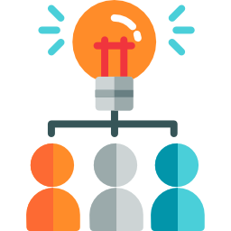
Brainstorming
Create a list of ideas and pick one. Keep the following in mind:
It does not have to be a game.
It should be something you have an interest in.
No idea is a bad idea.
You must:
Have multiple users/players interact in the app.
Use a Firebase database and React.

Slide 7
Software Requirement Specifications
Software requirements are a description of how your project behaves.
They drive what you design and implement.
Understanding what your project is going to do from the start can save time.
They might change as you understand your project better, and that’s OK.

Slide 8
Tic-tac-toe Requirements
When the first user enters the game the game will wait for one, and only one other user to also enter the game.
When the second user enters the game a 3x3 grid will be displayed and prompt the first user to click a square on the grid.
When the first user clicks a square an X will be displayed in that square and the second user will be prompted to click a square on the grid.
When the second user clicks a square O will be displayed in that square and the first user will again be prompted to click a square.

Slide 9
Tic-tac-toe Requirements
Steps 2 through 4 will repeat until one of the following occurs:
There are three X’s in a row, column, or diagonally.
There are three O’s in a row, column, or diagonally.
All squares are filled with an X or an O.
If step 5a is reached the first user will be declared the winner. If step 5b is reached the second user will be declared the winner. If step 5c is reached a draw will be declared.

Slide 10
Tic-tac-toe Requirements
Think about as many scenarios and corner-cases as you can. Here are some that were missing from the tic-tac-toe example:
What does the first user see while waiting for another user to play the game?
What happens if a third user tries to enter the game?
What if a user clicks a square that already has an X or an O?
When writing your requirements think about the minimum viable product (MVP). What is the minimum behavior to implement your idea? Only after discovering requirements for this should you think about stretch goals.

Slide 11
Wireframing
Notes:
Ask a student to explain what wireframing is.

Slide 12
Wireframing
Use your requirements to inform your wireframing.
Think about all the different states of your app and make sure you draw wireframes for them.
For example the tic-tac-toe app has:
A message to show when the first user is waiting for the second.
A 3x3 grid with X’s and O’s when the game is being played.
Three possible messages to display when the game is won or tied.

Slide 13
Project Timeline
April 1st | Engage in collaborative brainstorming to build consensus around a project idea. Create a project plan to accomplish specific tasks within a predetermined amount of time. (TODAY)
April 8th | Map over an array
April 1th | Read session metadata from Firebase
April 22nd | Holiday: Spring Break
April 29th | Write data to firebase and listen for changes to data from firebase
May 6th | Design and implement a data model
May 13th | Handle data changes in React
May 20th | Extension idea: Refactor a React component into sub-components and Add styles to a React component
May 27th | Holiday: Memorial Day
June 3rd | Prepare for and practice a project presentation
Notes:
Update this for your class dates

Slide 14
Objectives
Objectives are the individual goals and requirements you want to complete for your project.
Goals and dates will help you track progress and keep focused on the project.
Requirements of your app should inform what objectives you pick.
Objectives can change (time-constraints, unfeasible, requirements change).
But having a plan to start off with helps even if it changes.

Slide 15
Tic-tac-toe Objectives
Players can join the game.
Requirement 1
Date: 04-15-2020
Draw the tic-tac-toe grid when both players have joined.
Requirement 2
Date: 04-22-2020
Clicking a grid square draws an X for the first player and O for the second player.
Requirements 3 & 4
Date: 04-29-2020

Slide 16
Tic-tac-toe Objectives
The game can identify when a player has won and display an appropriate message.
Requirements 5 & 6
Date: 05-06-2020
The game can identify when a player has lost and display an appropriate message.
Requirements 5 & 6
Date: 05-13-2020

Slide 17
read session metadata from Firebase
Vocabulary: session metadata
Notes:
Teacher Notes:
Have your students read aloud the objective.
Students should read through each vocabulary word.
teams will read session metadata to determine who is playing their game.

Slide 18
Session Metadata
A session starts when user logs on or accesses a web page/app/program and ends when they log out.
Can temporarily store information related to the connected user(s)
Notes:
So what is a session?
a session starts when a user logs on to or accesses a particular web page, app, or program. A session ends when that user logs out… so you can think of it as a period of time of communication between two systems
During a session, you can temporarily store information related to the connected users(s) --- session metadata is some of this information

Slide 19
Session Metadata
To support collaboration:
need to identify when multiple people are participating in app
need to distinguish one user from another
We use session metadata to do this
Notes:
So why do we care about session metadata?
Project requirement is for student’s apps to support “collaboration” between users.
In order to do this, an application needs to be able to identify when multiple people are participating in this application, and needs to be able to distinguish one user from another.
We can use firebase session metadata to retrieve user information (and thus accomplish these above requirements).
We will cover how to use this data to build out “multiplayer” functionality throughout the rest of the slides.

Slide 20
Create New Game Data
Add data about your game into src/gameData.js
min/maxUsers number will be different if have variable number of “players” (e.g. chatroom)
const gameData = {
chatroom: { ... },
tictactoe: {
title: "Tic Tac Toe",
authors: "Joe Tessler",
description: "The classic two-player game with Xs and Os",
minUsers: 2,
maxUsers: 2,
component: TicTacToe,
},
}

Slide 21
Create Component for your App
Create a new directory for you app under src/game/nameofyourapp
Create a new component for your application.
Make sure that your component extends GameComponent
import GameComponent from '../../GameComponent.js';
import React from 'react';
export default class TicTacToe extends GameComponent {
render() {
return (
<div> This is my component </div>
);
}
}

Slide 22
Retrieve Session Data
import GameComponent from '../../GameComponent.js';
import React from 'react';
export default class TicTacToe extends GameComponent {
render() {
var id = this.getSessionId();
var users = this.getSessionUserIds().map((user_id) => (
<li key={user_id}>{user_id}</li>
));
var creator = this.getSessionCreatorUserId();
return (
<div>
<p>Session ID: {id}</p>
<p>Session creator: {creator}</p>
<p>Session users:</p>
<ul> {users} </ul>
</div>
);
}
}

Slide 23
Retrieve Session Data
gets the ID for the current session (as stored in Firebase)
import GameComponent from '../../GameComponent.js';
import React from 'react';
export default class TicTacToe extends GameComponent {
render() {
var id = this.getSessionId();
var users = this.getSessionUserIds().map((user_id) => (
<li key={user_id}>{user_id}</li>
));
var creator = this.getSessionCreatorUserId();
return (
<div>
<p>Session ID: {id}</p>
<p>Session creator: {creator}</p>
<p>Session users:</p>
<ul> {users} </ul>
</div>
);
}
}

Slide 24
Retrieve Session Data
import GameComponent from '../../GameComponent.js';
import React from 'react';
export default class TicTacToe extends GameComponent {
render() {
var id = this.getSessionId();
var users = this.getSessionUserIds().map((user_id) => (
<li key={user_id}>{user_id}</li>
));
var creator = this.getSessionCreatorUserId();
return (
<div>
<p>Session ID: {id}</p>
<p>Session creator: {creator}</p>
<p>Session users:</p>
<ul> {users} </ul>
</div>
);
}
}
gets list of IDs for users connected to the current session

Slide 25
Retrieve Session Data
import GameComponent from '../../GameComponent.js';
import React from 'react';
export default class TicTacToe extends GameComponent {
render() {
var id = this.getSessionId();
var users = this.getSessionUserIds().map((user_id) => (
<li key={user_id}>{user_id}</li>
));
var creator = this.getSessionCreatorUserId();
return (
<div>
<p>Session ID: {id}</p>
<p>Session creator: {creator}</p>
<p>Session users:</p>
<ul> {users} </ul>
</div>
);
}
}
gets the ID of the user who created this current session

Slide 26
Retrieve Session Data
import GameComponent from '../../GameComponent.js';
import React from 'react';
export default class TicTacToe extends GameComponent {
render() {
var id = this.getSessionId();
var users = this.getSessionUserIds().map((user_id) => (
<li key={user_id}>{user_id}</li>
));
var creator = this.getSessionCreatorUserId();
return (
<div>
<p>Session ID: {id}</p>
<p>Session creator: {creator}</p>
<p>Session users:</p>
<ul> {users} </ul>
</div>
);
}
}

Slide 27
Retrieve Session Data
import GameComponent from '../../GameComponent.js';
import React from 'react';
export default class TicTacToe extends GameComponent {
render() {
var id = this.getSessionId();
var users = this.getSessionUserIds().map((user_id) => (
<li key={user_id}>{user_id}</li>
));
var creator = this.getSessionCreatorUserId();
return (
<div>
<p>Session ID: {id}</p>
<p>Session creator: {creator}</p>
<p>Session users:</p>
<ul> {users} </ul>
</div>
);
}
}

Slide 28
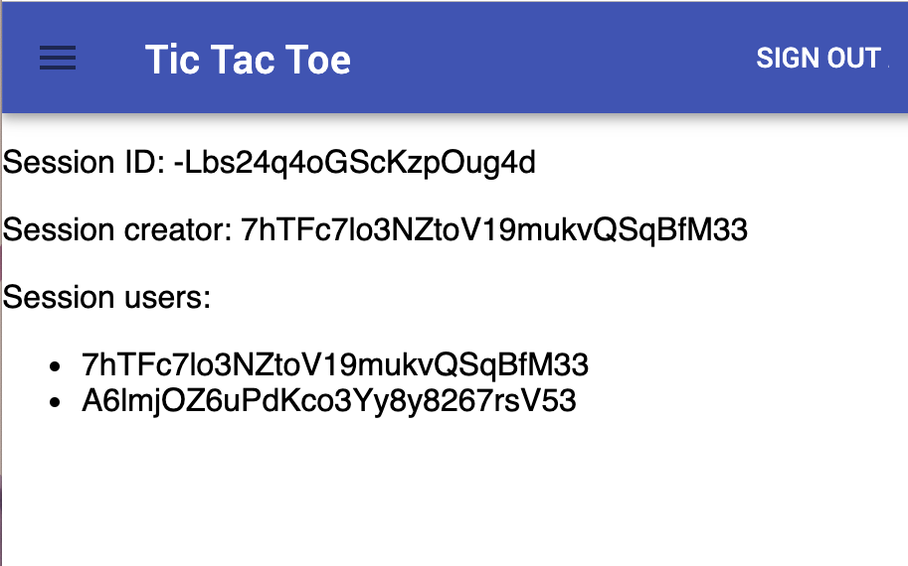
Retrieve Session Data
import GameComponent from '../../GameComponent.js';
import React from 'react';
export default class TicTacToe extends GameComponent {
render() {
var id = this.getSessionId();
var users = this.getSessionUserIds().map((user_id) => (
<li key={user_id}>{user_id}</li>
));
var creator = this.getSessionCreatorUserId();
return (
<div>
<p>Session ID: {id}</p>
<p>Session creator: {creator}</p>
<p>Session users:</p>
<ul> {users} </ul>
</div>
);
}
}

Slide 29
Retrieve Session Data
import GameComponent from '../../GameComponent.js';
import React from 'react';
export default class TicTacToe extends GameComponent {
render() {
var id = this.getSessionId();
var users = this.getSessionUserIds().map((user_id) => (
<li key={user_id}>{user_id}</li>
));
var creator = this.getSessionCreatorUserId();
return (
<div>
<p>Session ID: {id}</p>
<p>Session creator: {creator}</p>
<p>Session users:</p>
<ul> {users} </ul>
</div>
);
}
}

Slide 30
Retrieve Session Data
import GameComponent from '../../GameComponent.js';
import React from 'react';
export default class TicTacToe extends GameComponent {
render() {
var id = this.getSessionId();
var users = this.getSessionUserIds().map((user_id) => (
<li key={user_id}>{user_id}</li>
));
var creator = this.getSessionCreatorUserId();
return (
<div>
<p>Session ID: {id}</p>
<p>Session creator: {creator}</p>
<p>Session users:</p>
<ul> {users} </ul>
</div>
);
}
}

Slide 31
Retrieve Session Data
import GameComponent from '../../GameComponent.js';
import React from 'react';
export default class TicTacToe extends GameComponent {
render() {
var id = this.getSessionId();
var users = this.getSessionUserIds().map((user_id) => (
<li key={user_id}>{user_id}</li>
));
var creator = this.getSessionCreatorUserId();
return (
<div>
<p>Session ID: {id}</p>
<p>Session creator: {creator}</p>
<p>Session users:</p>
<ul> {users} </ul>
</div>
);
}
}

Slide 32
UserApi
import GameComponent from '../../GameComponent.js';
import React from 'react';
import UserApi from '../../UserApi.js';
export default class TicTacToe extends GameComponent {
render() {
var id = this.getSessionId();
var users = this.getSessionUserIds().map((user_id) => (
<li key={user_id}>{UserApi.getName(user_id)}</li>
));
var creator = UserApi.getName(this.getSessionCreatorUserId());
return (
<div>
<p>Session ID: {id}</p>
<p>Session creator: {creator}</p>
<p>Session users:</p>
<ul> {users} </ul>
</div>
);
}
}
Notes:
Though useful, seeing long IDs is not particularly “human friendly”
What if we wanted to see something more meaningful?
We can use the “UserApi” library… specifically this getName() method.

Slide 33
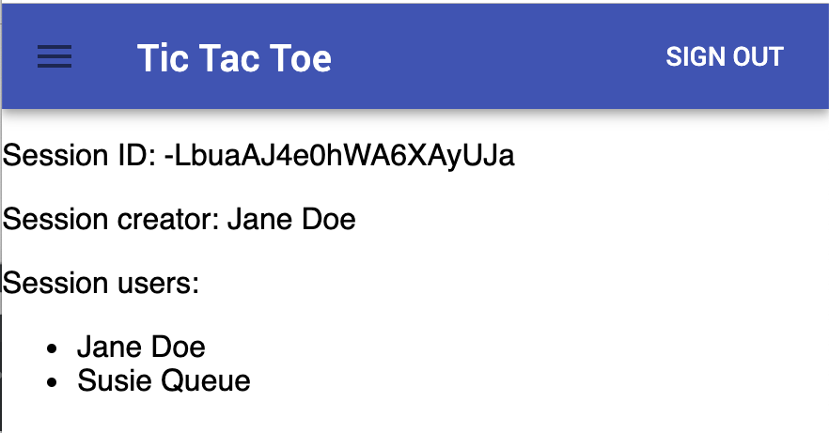
UserApi
import GameComponent from '../../GameComponent.js';
import React from 'react';
import UserApi from '../../UserApi.js';
export default class TicTacToe extends GameComponent {
render() {
var id = this.getSessionId();
var users = this.getSessionUserIds().map((user_id) => (
<li key={user_id}>{UserApi.getName(user_id)}</li>
));
var creator = UserApi.getName(this.getSessionCreatorUserId());
return (
<div>
<p>Session ID: {id}</p>
<p>Session creator: {creator}</p>
<p>Session users:</p>
<ul> {users} </ul>
</div>
);
}
}
Notes:
more info on UserApi library in the README: https://github.com/jtessler/studio-multiplayer-game
Methods in this library include:
UserApi.getName(uid): Returns the user's display name, e.g. "Joe Tessler"
UserApi.getPhotoUrl(uid): Returns the user's avatar photo URL to use in an <img> tag
UserApi.getLastSignIn(uid): Returns the user's last login date as a JavaScript Date object

Slide 34
Codesandbox Link
https://codesandbox.io/embed/2pq9w2v96j

Slide 35
Your Turn!
Fork:
https://github.com/jtessler/studio-multiplayer-game
Paste your github repo into Project Planning doc.
Notes:
only one student per group should fork repo

Slide 36
Your Turn!
Add new entry for you game into gameData object (src/gameData.js).
see slide 9 for correct format
Create a new directory and JS file for you component under src/game.
Use this.getSessionXXX() and UserApi methods to get information about users
Notes:
https://codesandbox.io/embed/2pq9w2v96j

Slide 37
Stretch Goals
use this.getMyUserId() and this.getSessionCreatorUserId() to determine if current user is the session creator.
Conditionally render “I am the host” or “I am the guest” to users.

Slide 38
write data to firebase and listen for changes to data from firebase
Direct Teach (10 m)
Vocabulary: session data
Notes:
Teacher Notes:
Have your students read aloud the objective.
Students should read through each vocabulary word.

Slide 39
Review of last class

Slide 40
Review of last class
We’re going to learn about a 6th function, to update game data by writing to Firebase database!

Slide 41
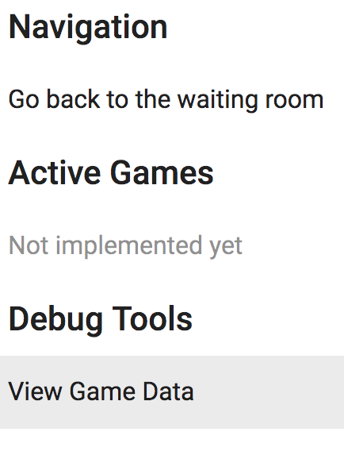
Viewing Game Data
You can view game data from Firebase by following these steps:
Click the hamburger menu
Click “View Game Data”
Click “Expand to see JSON View of Entire Database”
Notes:
Contextualize show them how they can see the data
https://studio-multiplayer-game.firebaseapp.com/dataViewer

Slide 42
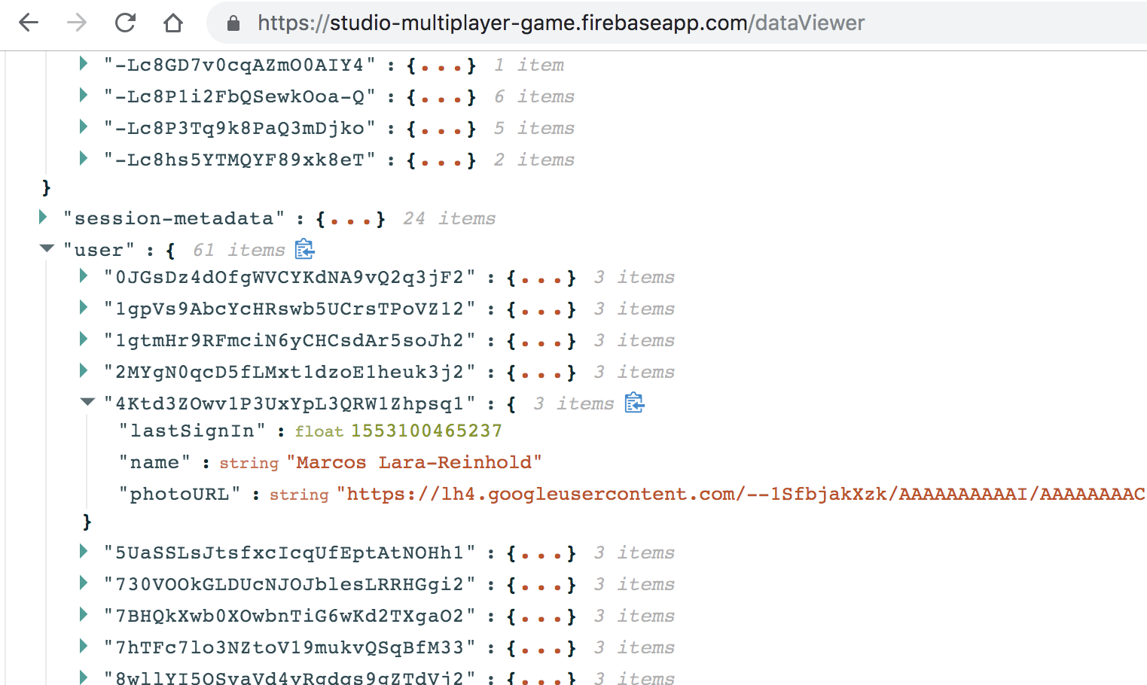
Viewing Game Data
Notes:
Contextualize show them how they can see the data
https://studio-multiplayer-game.firebaseapp.com/dataViewer

Slide 43
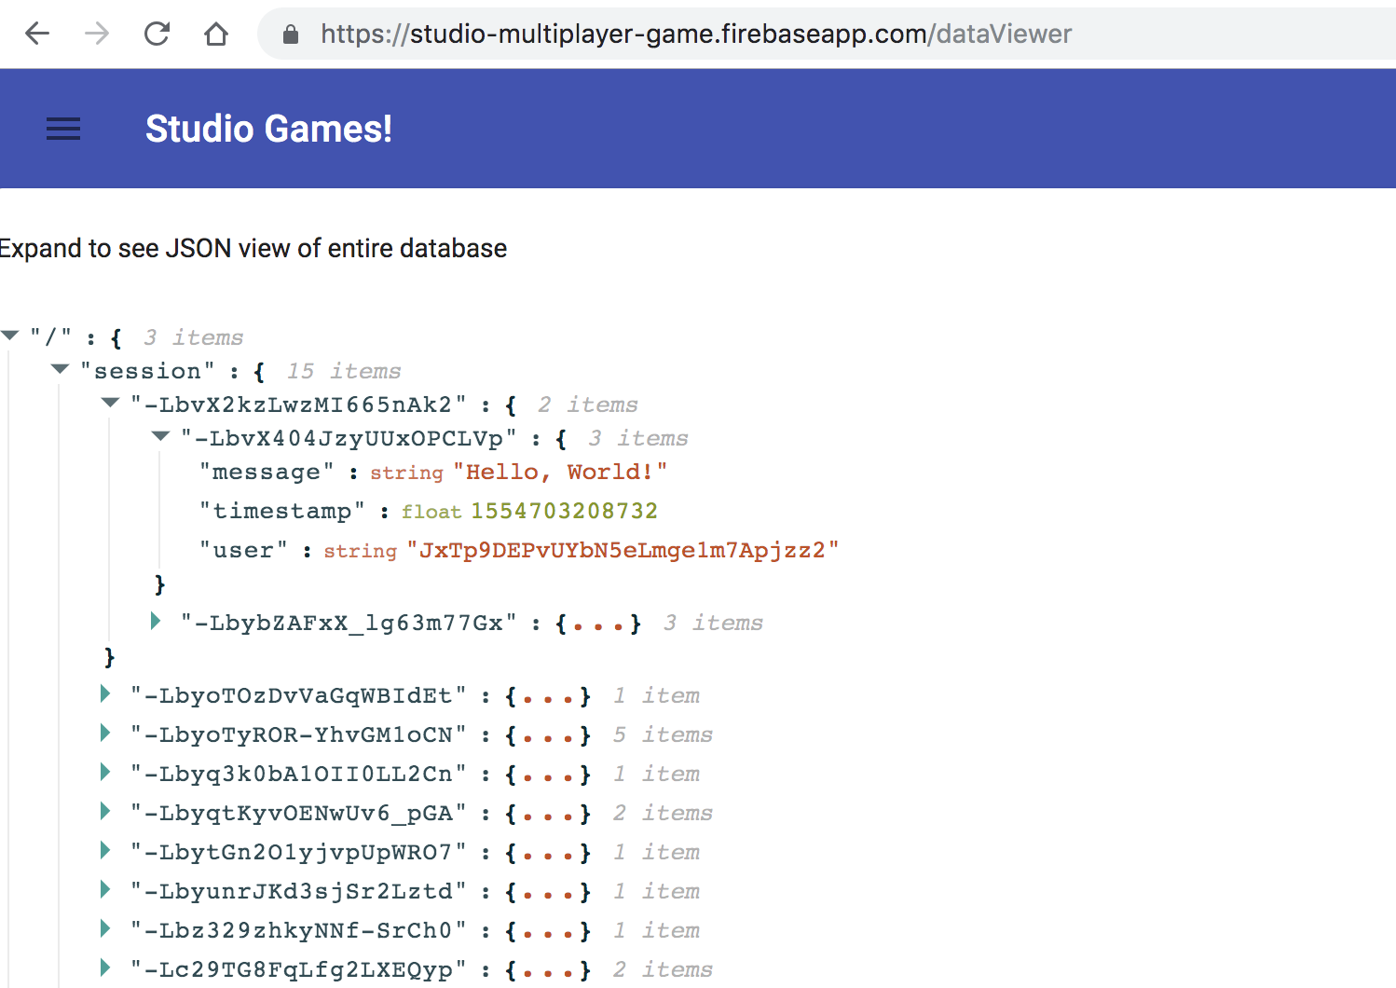
Viewing Game Data
Notes:
Contextualize show them how they can see the data
https://studio-multiplayer-game.firebaseapp.com/dataViewer

Slide 44
Updating game data
You can update game data by writing to the Firebase database by calling this function:
Notes:
getSessionDatabaseRef -> Returns firebase object

Slide 45
Code Sandbox Demo
Let’s see how it works!
Notes:
Show the changed data on Code Sandbox: https://codesandbox.io/s/y2z19pplpz?fontsize=14 (check Demo - Write Data)

Slide 46
Listen for game data changes
You can listen for game data changes in Firebase database
Notes:
Skip metadatachanged

Slide 47
Listen for game data changes
You can listen for game data changes in Firebase database
Don’t forget to extend GameComponent first, to give you access to the above callback function!
Notes:
Skip metadatachanged

Slide 48
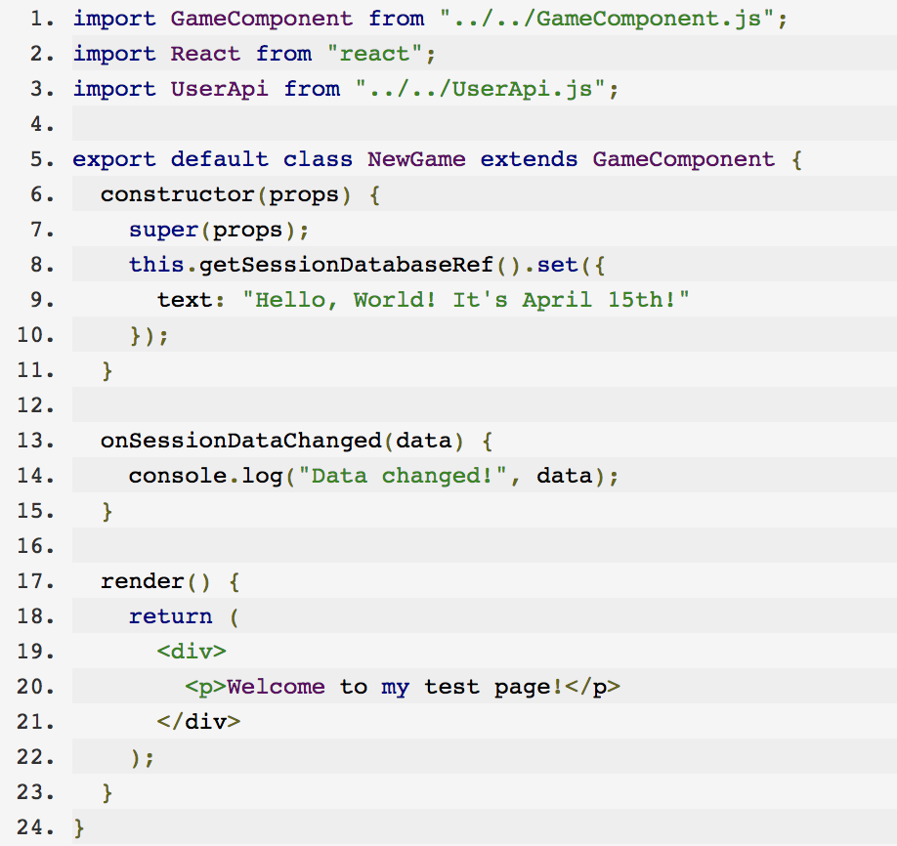
onSessionDataChanged()
What would we expect to see here?
Notes:
Skip onsessionmetadatachanged
Cut down what’s in the render function so that it’s not cluttered

Slide 49
onSessionDataChanged()
We should see “Data changed!” printed in the console after we write “Hello, World!” to Firebase and we call onSessionDataChanged()
Notes:
Skip onsessionmetadatachanged

Slide 50
Code Sandbox Demo
Let’s see how it works!
Notes:
Show the changed data on Code Sandbox - in Code Sanbox, check NewGame.js file

Slide 51
Displaying the user on button click
Let’s practice!
When a user clicks a button, we want to console.log the user name of the person who clicked

Slide 52
Displaying the user on button click
How should we implement this?
When the user clicks a button….

Slide 53
Displaying the user on button click
How should we implement this?
When the user clicks a button….
Write the user id to Firebase using functions we learned last class

Slide 54
Displaying the user on button click
How should we implement this?
When the user clicks a button….
Write the user id to Firebase using functions we learned last class
Listen for the Firebase data changes

Slide 55
Displaying the user on button click
How should we implement this?
When the user clicks a button….
Write the user id to Firebase using functions we learned last class
Log these changes (the user id) to the console
Listen for the Firebase data changes

Slide 56
Displaying the user on button click
How should we implement this?
handleButtonClick()
Write the user id to Firebase using functions we learned last class
Log these changes (the user id) to the console
Listen for the Firebase data changes

Slide 57
Displaying the user on button click
How should we implement this?
handleButtonClick()
getSessionDatabaseRef()
.set(...)
Log these changes (the user id) to the console
Listen for the Firebase data changes

Slide 58
Displaying the user on button click
How should we implement this?
handleButtonClick()
getSessionDatabaseRef()
.set(...)
Log these changes (the user id) to the console
.onSessionDataChanged()

Slide 59
Displaying the user on button click
How should we implement this?
handleButtonClick()
getSessionDatabaseRef()
.set(...)
console.log()
.onSessionDataChanged()

Slide 60
Code Sandbox Demo
Let’s see how it works!
Notes:
Show the changed data on Code Sandbox - On Code Sandbox check Demo - Button file!

Slide 61
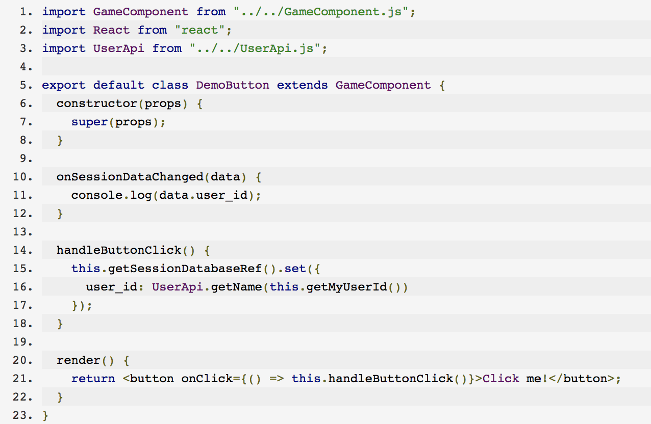
Solution

Slide 62
Remote
Unit 4: Session 5

Slide 63
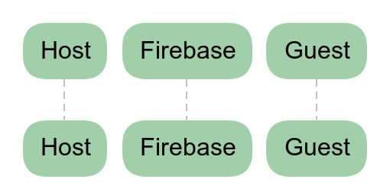
Review Firebase Data Flow
Notes:
First, lets go over what we learned last class.
What you're looking at on the screen is called a Sequence Diagram.
This one is empty to start, so bear with me for a second.
But even an empty sequence diagram can give you some insight.
This diagram tells me that the "actors" involved in your game are the Host, Firebase, and a Guest.
Sequence diagrams are useful because they can show the interactions between the entities involved in our application.
They are widely used in the industry to represent activity in an application involving multiple parties.
The bestي part about them is that they can show how that activity is handled with respect to time.
What I mean is that sequence diagrams can show what order things happen.
Let's walk through an example.

Slide 64
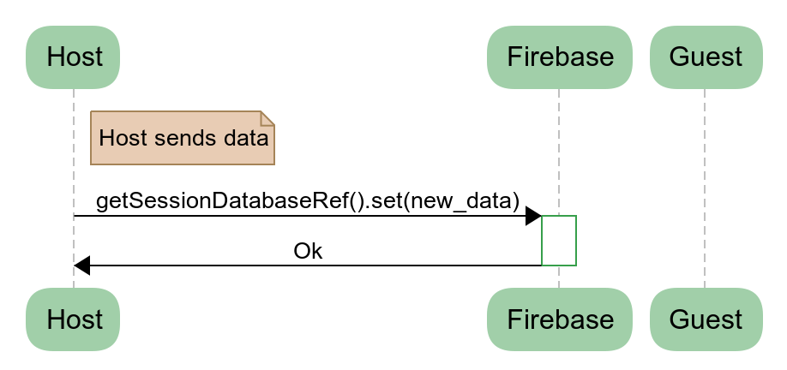
Review Firebase Data Flow
Notes:
Here's the first step.
Our host, puts together some data and sends it to Firebase.
You'll notice that in this diagram, i've explicitly shown you the method you'll be using - getSessionDatabaseRef.set
Firebase then tells you that it got the data.
That part is transparent.
Pause here for a second and ask if the students have any questions

Slide 65
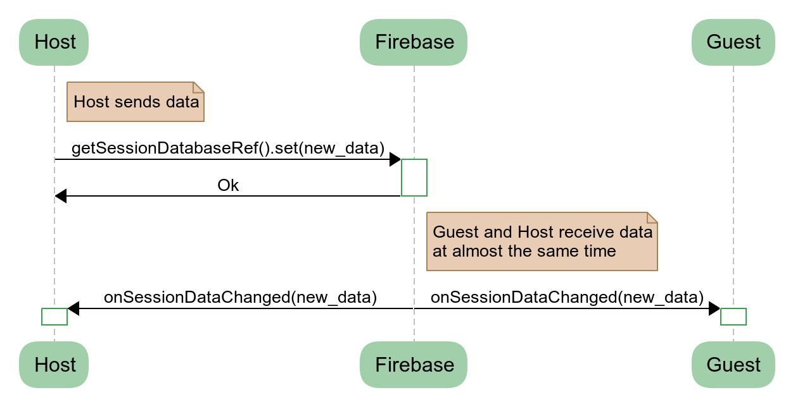
Review Firebase Data Flow
Notes:
Next, Firebase takes that new data and forwards it onto the Host and the Guest.
It does this via the onSessionDataChanged method in your code.
You'll notice that i've explicitly called out the fact that host and guest receive the data at almost the same time.
This happens because of network speeds, wifi and all that.
It's out of your control.
Just keep in mind that it's not going to be exactly the same time, there's "lag".
Also notice in this diagram that Firebase isn't changing the data.
Host gave it "new_data", and firebase simply passed that on.

Slide 66
Review Firebase Data Flow
Notes:
Next, Firebase takes that new data and forwards it onto the Host and the Guest.
It does this via the onSessionDataChanged method in your code.
You'll notice that i've explicitly called out the fact that host and guest receive the data at almost the same time.
This happens because of network speeds, wifi and all that.
It's out of your control.
Just keep in mind that it's not going to be exactly the same time, there's "lag".
Also notice in this diagram that Firebase isn't changing the data.
Host gave it "new_data", and firebase simply passed that on.

Slide 67
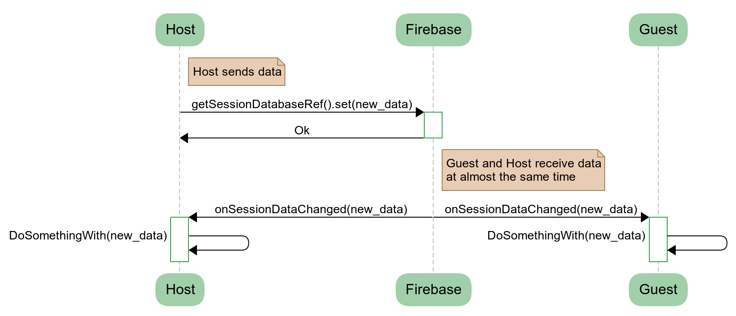
Review Firebase Data Flow
Notes:
When the Host and the Guest receive new_data, they do something with it.
That part is up to you and will be the core of your game.
For example, if you're building tic tac toe, when the Host places an "X" on the board, you should update your display.
Pause here for a second to see if everyone is following

Slide 68
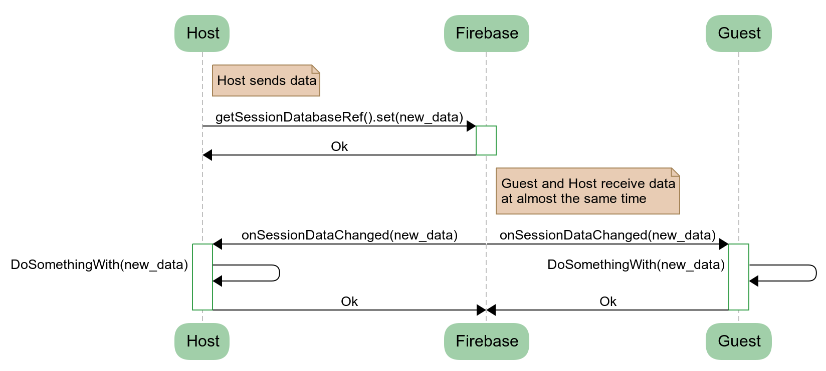
Review Firebase Data Flow
Notes:
And finally both the Host and the Guest respond back to Firebase.
Quick quiz (if there's some time)
If there are 4 players in your game, how many actors would there be in this diagram?
Answer: 5, 4 players and Firebase

Slide 69
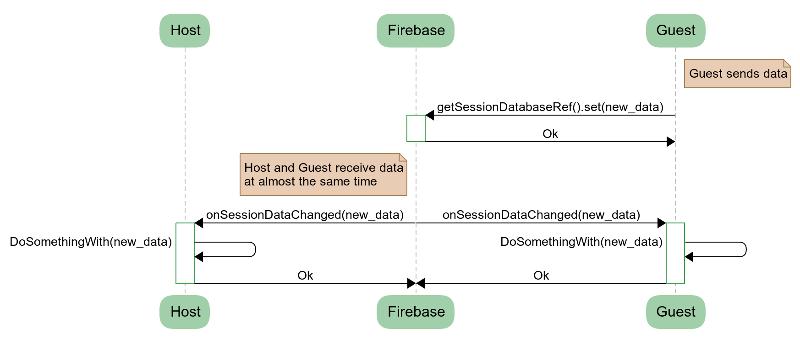
Review Firebase Data Flow
Notes:
And just like in the previous diagram, here is what it looks like when the Guest sends data.
Everything is the same, but reversed.
In a turn based 2 person game, this diagram accurately represents your game.
Pause here for a bit and ask the students if they are comfortable with this diagram.
Answer any questions they have.
Lead into next slide:
Ok, I think we get the "how" of the Host/Guest communication
But… *next slide*

Slide 70
What are Player 1 and Player 2 sending each other?
Notes:
In the previous lesson, we put some text into Firebase and saw how it flowed through the system.
But your games are going to need to do a little bit more than that.
So, what is it called? The data that you put into Firebase?
Some of you might remember the term from Unit 2 with respect to our Kahoot game.
Pause here to see if the students can remember the term "data model"
If yes, continue to next slide
If not, continue below
The thing that goes into Firebase is our...

Slide 71
Data Model
"All models are wrong, but some are useful"
George Box
Notes:
Pause for a second here and let the class read the slide.
Here is a quote from the statistician George Box.
His famous aphorism reminds us that when modeling, value simplicity and usefulness over other factors.
And remember, data models can and should evolve.

Slide 72
What is one piece of your data model that you will need to pass between players for the game you are building?
Join at slido.com #flw2
Notes:
📣 This is Slido interaction slide, please don't delete it. ✅ Click on 'Present with Slido' and the poll will launch automatically when you get to this slide.

Slide 73
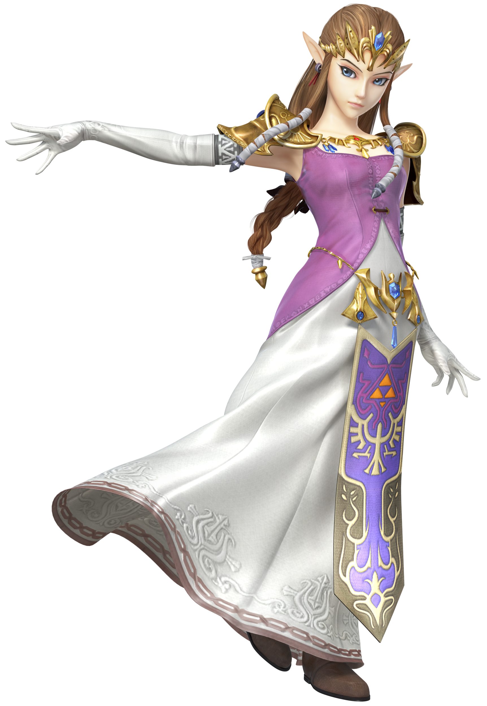
design and implement a data model.
Vocabulary: data model
Notes:
That leads us into our objective for this week:
Teams will represent their game's state in a data model.
Ask the students to guess who the characters on screen are.
Left: Fortnite Whiplash Skin
Right: Princess Zelda

Slide 74
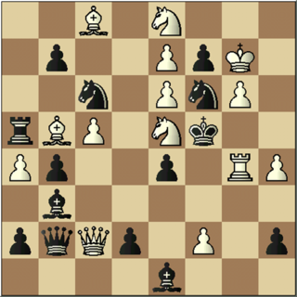
Mini-Lesson: Data Vs Logic
Data:
White Knight at King 8
Logic:
Knights can only move in L
Knights can jump over other pieces
Notes:
But before we jump into data models, I want to speak to a potential culdesac you might run into.
On the screen here we have a chess board and it seems like the game is well underway.
If I asked you to represent the state of the game, you might tell me what piece is where right?
I would call that data.
On the other hand, if I didn't know how to play chess, you'd also have to explain to me the rules of the game.
That is the logic, or algorithm, of the game.
When you think of data models, think about the data and not the logic.
Soon, you'll be able to identify the two parts in any system, and that will help you a lot when you're programming.
Because..

Slide 75
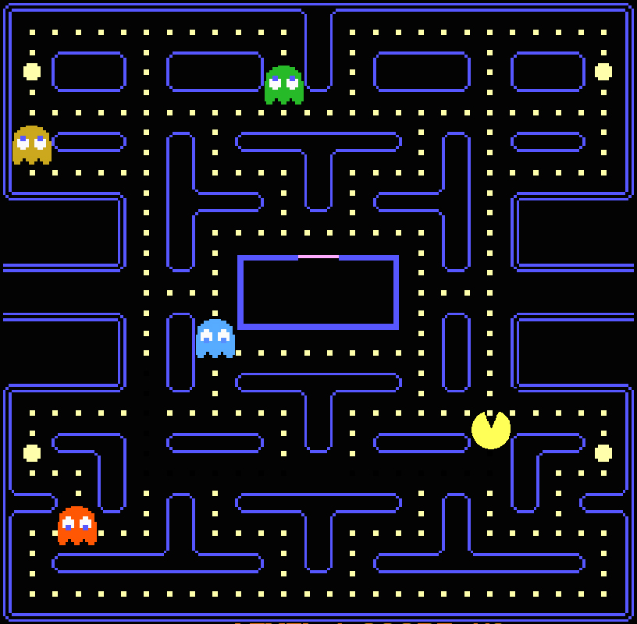
This has a data model

Slide 76
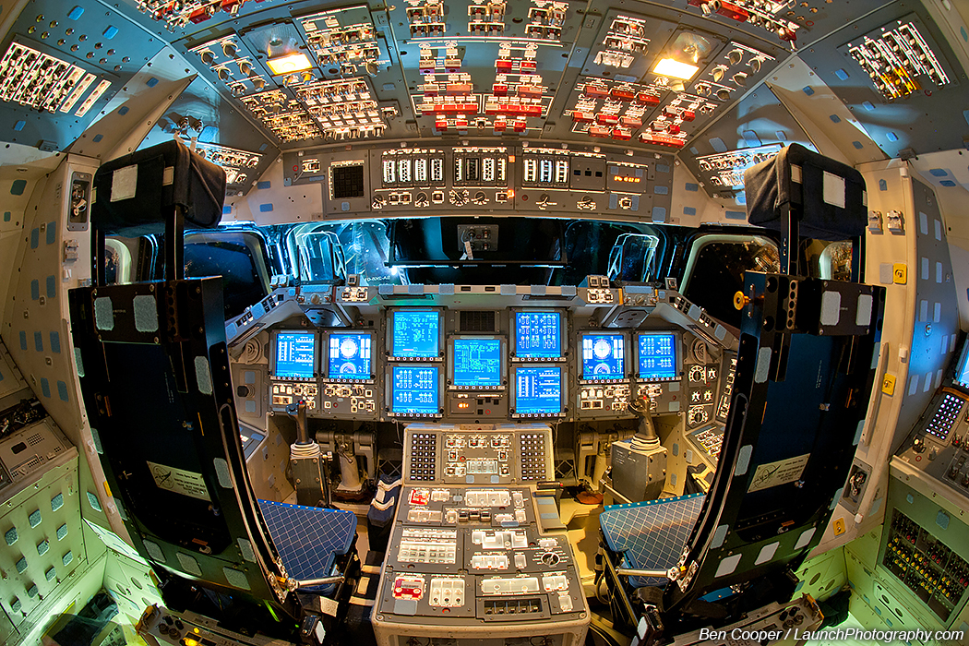
This has a data model too
Notes:
This is the inside of the space shuttle Endeavour.
Pause here for questions.

Slide 77
Sort the following examples into logic or data:
It is currently player 1's turn in chess
There is an X in the top left corner of the tic tac toe board
The user has a banana in their shopping cart
The maximum number of shopping cart items is 10
In checkers, when a piece gets to the opposite side from where it started, it turns into a king
There is a red king checker in position 1A

Slide 78
Choose ALL of the following statements that are data.
Join at slido.com #flw2
Notes:
📣 This is Slido interaction slide, please don't delete it. ✅ Click on 'Present with Slido' and the poll will launch automatically when you get to this slide.

Slide 79
Explain the difference between logic and data in your own words.
Join at slido.com #flw2
Notes:
📣 This is Slido interaction slide, please don't delete it. ✅ Click on 'Present with Slido' and the poll will launch automatically when you get to this slide.

Slide 80
Examples of
Data Models

Slide 81
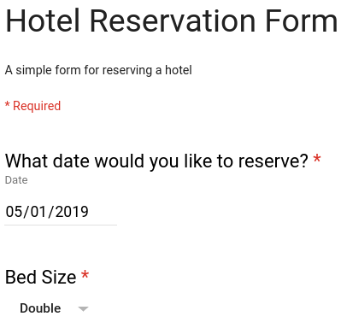
Data Model Example 1 - HTML Form
Data Model:
{
"date": "05/01/2019",
"bed_size": "Double"
}
Notes:
A very simple data model for a hotel reservation form.
On the left you see the form, the user is asked to insert a date and a bed size.
They've selected May 1 and Double and you can see that represented as state on the right.

Slide 82
Data Model Example 1 - HTML Form
Data Model:
{
"date": "05/01/2019",
"bed_size": "Double"
}
Date
Hotel Reservation
Bed Size
Notes:
As you can see, it doesn't take much to represent this form.
And you were building a 2 person form, you could easily just send these two pieces of data to Firebase.

Slide 83
Data Model Example 2 - RPS
The data model should be able to tell you what is the state of the game at any given time.
{
"player1Score": 4,
"player2Score": 2,
"player1CurrSelection": "Rock",
"revealSelections": false
}

Slide 84
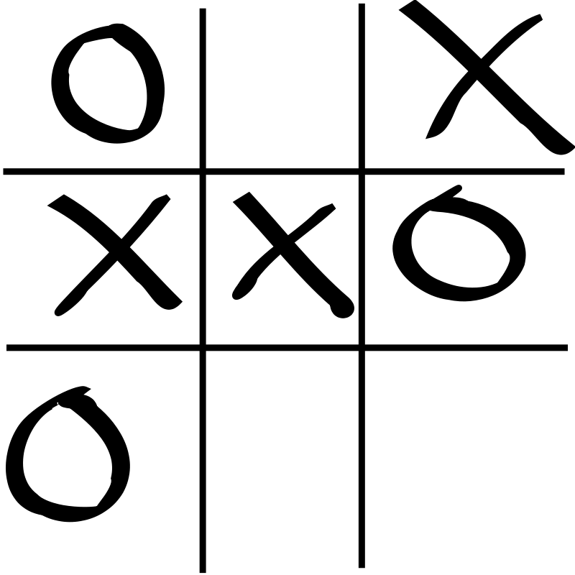
Data Model Example 3 - Tic Tac Toe
Remember:
Data not logic
Represent the current state
Think about the players
Notes:
Here is an example of a Tic Tac Toe game in progress.
Ask the class to work with their neighbours to "define"/"design" the data model for this game.
The data model should be able to tell you what is the state of the game at any given time
Before they get started, quickly run through the "Remember" section
Data not logic
Represent the current state
Think about the players
Ask for a team to volunteer their data model
Make sure it contains "current player"
Draw the students' data model on the whiteboard.
Tell the students that you want to use this data model to finish the game
You will be acting as firebase
Ask for a volunteer to be X and O
Explain that in this case, you are going to be firebase
Tell X that its their move
When they suggest a move, draw an X in the spot and ask the class how the state should change in the data model
Then update the whiteboard
Do this for one more move with O

Slide 85
Slido: what's missing from this data model?
A data model should contain all
information to describe the state
of a game. What’s missing from
this data model?
const ticTacToeModel = {
position = [ ‘O’,‘-’,‘X’,‘X’,‘X’,‘O’,‘O’,‘-’,‘-’],
};

Slide 86
A data model should contain all information to describe the state of a game. What’s missing from this data model?const ticTacToeModel = {position = [‘O’,‘-’,‘X’,‘X’,‘X’,‘O’,‘O’,‘-’,‘-’],};
Join at slido.com #flw2
Notes:
📣 This is Slido interaction slide, please don't delete it. ✅ Click on 'Present with Slido' and the poll will launch automatically when you get to this slide.

Slide 87
Your turn
Design your data model as a JavaScript object Use your project planning document
Ensure you can read from and write to Firebase
Use your data model to power your game

Slide 88
handle data changes in React.
Vocabulary: user input, conditional rendering

Slide 89
Data Model Review: Tic Tac Toe
What information do we need to “remember”?
Cells 1, 2, 3, …, 9 Either ‘X’, ‘O’, or blank
Whose turn is it? Player 1 or 2?
Notes:
Both bullet points appear in an animation

Slide 90
Data Model Review: Tic Tac Toe
Tic Tac Toe
cell_state: [
"O", ".", "X",
"X", "X", "O",
"O", ".", "."
],
current_player: "X"
Cell State
Current Player
Cell 0
Cell 1
Cell 2
Cell 3
Cell 4
Cell 5
Cell 6
Cell 7
Cell 8

Slide 91
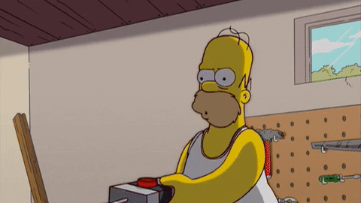
What happens if...
I click on a cell?

Slide 92
User input and Data Model changes
What happens if I am Player “X” and I press on Cell 1?
cell_state: [
"O", ".", "X",
"X", "X", "O",
"O", ".", "."
],
current_player: "X"
cell_state: [
"O", "X", "X",
"X", "X", "O",
"O", ".", "."
],
Tic Tac Toe
Cell State
Current Player
Current Player
Cell 0
Cell 1
Cell 2
Cell 1
Cell 3
Cell 4
Cell 5
Cell 6
Cell 7
Cell 8
current_player: "O"
Notes:
There are animations to make the Data Model changes appear in the following order:
Cell 1 on the data model diagram turns orange
Cell 1 in the cell_state data model set to “X”
The current_player data model set to “O”

Slide 93
User input and Data Model changes
What happens if I am Player “X” and I press on Cell 1?
cell_state: [
"O", "X", "X",
"X", "X", "O",
"O", ".", "."
],
current_player: "O"
handleButtonClick(i) {
var newCellState = this.state.cellState;
newCellState[1] = "X";
this.getSessionDatabaseRef().update({ cell_state: newCellState,
current_player: "O", }); }
Notes:
The code blocks appear in animation steps

Slide 94
User input and Data Model changes
POP QUIZ: Is this function updating React state?
Answer: No, it’s updating the Firebase DB
We update React state in the onSessionDataChanged(data) function
handleButtonClick(i) {
var newCellState = this.state.cellState;
newCellState[1] = "X";
this.getSessionDatabaseRef().update({ cell_state: newCellState,
current_player: "O", }); }

Slide 95
User input and Data Model changes
POP QUIZ: Is this function updating React state?
Answer: Yes! We update React state whenever the Firebase database changes
We update React state in the this.setState({ … }) function
onSessionDataChanged(data) {
this.setState({
cellState: data.cell_state,
currentPlayer:
data.current_player,
});
}

Slide 96
Handling MY TURN vs. YOUR TURN
Wait… How do I know if I’m player “X”?
getMyTicTacToePiece() {
var myUserId = this.getMyUserId(); var creatorUserId = this.getSessionCreatorUserId();
if (myUserId === creatorUserId) {
return "X";
} else { return "O"; } }
Notes:
The code blocks appear in animation steps

Slide 97
Handling MY TURN vs. YOUR TURN
Use this.getMyTicTacToePiece() to conditionally save “X” or “O” depending on whose turn it is to play
handleButtonClick(i) {
var newCellState = this.state.cellState;
newCellState[1] = this.getMyTicTacToePiece();
this.getSessionDatabaseRef().update({ cell_state: newCellState, current_player: this.getOtherTicTacToePiece(), }); }
handleButtonClick(i) {
var newCellState = this.state.cellState;
newCellState[1] = "X";
this.getSessionDatabaseRef().update({ cell_state: newCellState, current_player: "O", }); }
handleButtonClick(i) {
var newCellState = this.state.cellState;
newCellState[1] = this.getMyTicTacToePiece();
this.getSessionDatabaseRef().update({ cell_state: newCellState, current_player: "O", }); }
Notes:
The code blocks appear in animation steps

Slide 98
Use map to render Tic Tac Toe buttons
handleButtonClick(i) {
var newCellState = this.state.cellState;
newCellState[1] = this.getMyTicTacToePiece();
this.getSessionDatabaseRef().update({ cell_state: newCellState, current_player: this.getP2TicTacToePiece(), }); }
handleButtonClick(i) {
var newCellState = this.state.cellState;
newCellState[i] = this.getMyTicTacToePiece();
this.getSessionDatabaseRef().update({ cell_state: newCellState, current_player: this.getP2TicTacToePiece(), }); }
What’s wrong with our click handler?
It only updates cell 1
render() {
var buttons = this.state.cellState.map((state, i) => (
<button onClick={() => this.handleButtonClick(i)}> {state} </button> ));
return ( <div>{buttons[0]} {buttons[1]} ...</div> ); }
Map each cell to a unique click handler
Notes:
The second code block appears in line-by-line animation steps

Slide 99
Handling when it’s NOT YOUR TURN
How do I know if it is my turn?
isMyTurn() {
var myPiece = this.getMyTicTacToePiece(); // X or O var currentPiece = this.state.currentPlayer; // X or O
if (myPiece === currentPiece) {
return true;
} else { return false; } }
Notes:
The code blocks appear in animation steps

Slide 100
Handling when it’s NOT YOUR TURN
Use this.isMyTurn() and the disabled prop to conditionally “turn off” the button when it’s not your turn
render() {
var buttons = this.state.cellState.map((state, i) => (
<button onClick={() => this.handleButtonClick(i)}>
{state} </button> ));
return ( <div>{buttons[0]} {buttons[1]} ...</div> ); }
render() {
var buttons = this.state.cellState.map((state, i) => (
<button onClick={() => this.handleButtonClick(i)}
disabled={!this.isMyTurn()}> {state} </button> ));
return ( <div>{buttons[0]} {buttons[1]} ...</div> ); }
Notes:
The updated code block appear in animation steps

Slide 101
Other things to conditionally consider
Add a banner showing the current player var user = this.getCurrentPlayerUserId(); // TODO: Write this! var banner = "It's " + UserApi.getName(user) + "'s turn!";
Check if the game is done var indexOfBlankCell = this.state.cellState.indexOf("."); var isStalemate = indexOfBlankCell === -1;
Use Firebase update(), not set() this.getSessionDatabaseRef().update({ … });

